Slide 1
Forecasting Financial Time Series Data
Xavier miles

Slide 2
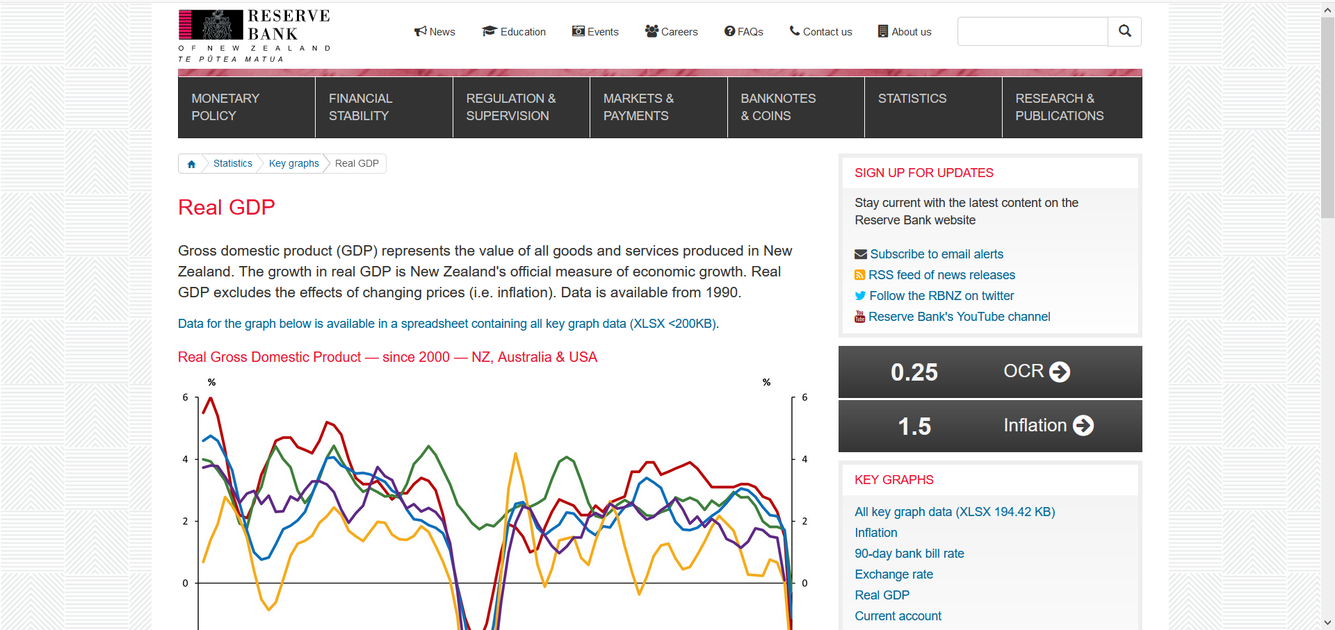
Data
Notes:
This excel dataset contains various measures of the New Zealand economy including: GDP – economic output, CPI – inflation, TWI – exchange rate/value of NZD

Slide 3
Research Question
Forecast the GDP annual growth rate for the next 3 years.
Since this is a times series, our model will be constructed to make predictions for present/future values based on the past values.
Using a Bayesian approach will give us flexibility with resulting inferences and confidence bands. Also helps prevent issues related to small sample size (relative to complexity of model).
Notes:
Bayesian approach: Flexible approach to drawing out statistical inferences and constructing bands to represent our confidence in predictions.
Also handles problems caused by small sample size (relative to number of parameters).

Slide 4
The Model - BAR
Investigate the relationship between the current GDP growth and the GDP growth from the previous two quarters.
Use this relationship to predict future GDP growth values.
This will be achieved by setting the LHS to the next quarter and calculating. Then repeat this process moving one quarter ahead at a time.
Notes:
One period = one quarter

Slide 5
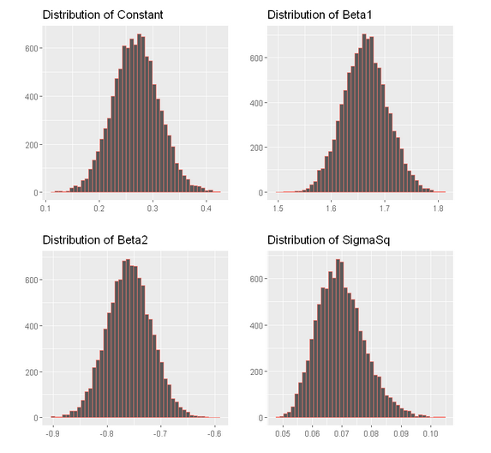
Posterior Inference
c = 0.27
Beta1 = 1.66
Beta2 = -0.75
SigmaSq = 0.07
Notes:
Each draw of the Gibbs sampler gives us sample values for the parameters. In the plots below, we can see that the beta coefficients look to be normally distributed, which would be expected since the prior and likelihood function were both defined to be normal. The sigma2 parameter seems to be roughly normally distributed, except for a slight right skew.
The posterior means of the four parameters are also printed, and these are the posterior estimates for the corresponding parameter. Since beta1
estimate is positive, there is a positive relationship between the GDP of the current quarter and GDP of the previous quarter, meaning that a high GDP in one quarter means it is likely there will also be a high GDP in the next quarter (and vice versa). Since beta2 estimate is negative, there is a negative relationship between the GDP of the current quarter and GDP two quarters ago. The 𝜎 estimate is relatively small, the volatility of the GDP numbers from quarter to quarter is relatively small; or equivalently, the GDP data from the two previous quarters can be used to predict the current GDP relatively accurately.

Slide 6
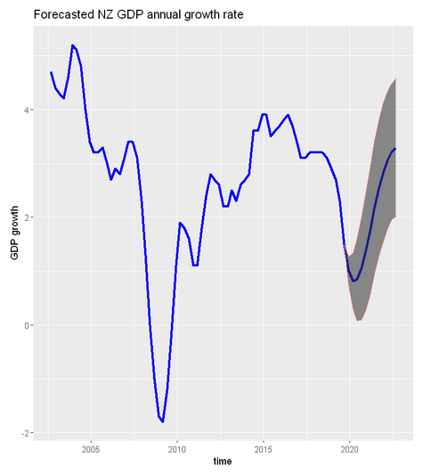
Predictions

Slide 7
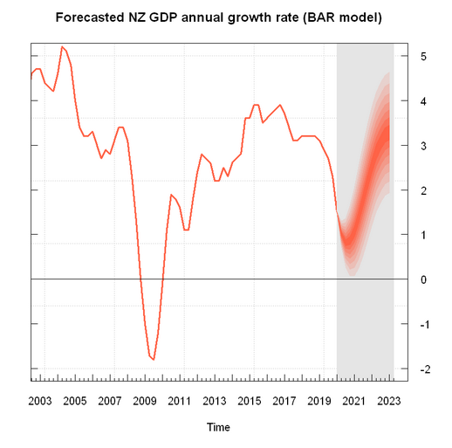
Predictions
Notes:
Our forecast seems quite positive, with a mean predicted annual growth rate at around 3.2% by 2023.
There seems to be a fair bit of upside risk with the upper bound of the 95% credible interval reaching nearly 4.5% by 2023. The graph indicates that it is highly unlikely that there will be negative NZ GDP growth over the next three years, with the lower bound of the 95% credible interval only just managing to avoid intersecting zero at it's lowest point.
This is somewhat surprising considering how steeply the annual growth rate has been dropping in the last few periods and the generally pessimistic outlook of many people about prospects for the global economy over the next few years, but perhaps a (more complex) model which included other economic variables would forecast worse annual NZ GDP growth rates over the next few years.

Slide 8
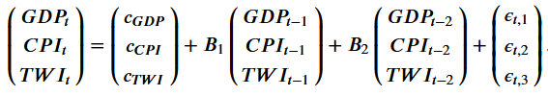
New Model - BVAR
Still investigating the relationship between current GDP growth and GDP growth from previous two quarters.
Introduce two new predictor variables: CPI and TWI. These will both be from the previous two quarters.
Notes:
The B matrices are

Slide 9
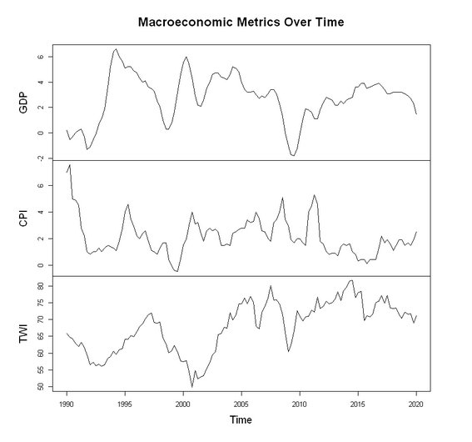

Slide 10
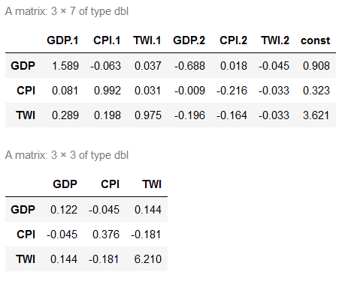
Posterior Inference

Slide 11
Posterior Inference
Below is the relationship for the GDP growth part of the model.
GDP growth has a negative relationship with CPI of both previous quarters.
GDP growth is still positively related to the GDP growth one quarter ago, and negatively related to the GDP growth from two quarters ago.
TWI seems less significant, based on the size of the coefficients.
Notes:
We can see that the GDP growth rate has a negative relationship with the CPI of both previous quarters. This makes sense since higher inflation CPI is seen as leading to worse economic growth (GDP). However, it is interesting that the current GDP growth rate has a stronger relationship with the CPI from 2 quarters ago than the CPI from 1 quarter ago. This might be because the macroeconomic factors may take longer than three months to affect each other.
The GDP growth rate has a positive and negative relationship with the TWI from one and two quarters ago, repectively. The magnitude of these coefficients is far smaller than the magnitude of the coefficients for CPI, which means the lagged TWI is less influential in predicting the current/future GDP growth rate.
We can take the posterior means of the Σ
draws as a point estimates for the covariance matrix.

Slide 12
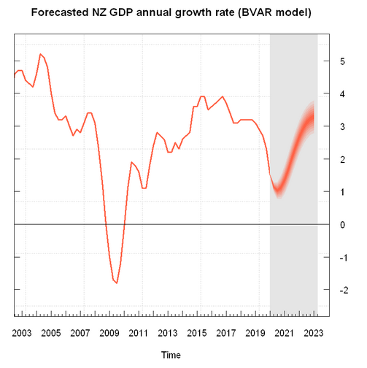
Forecast

Slide 13
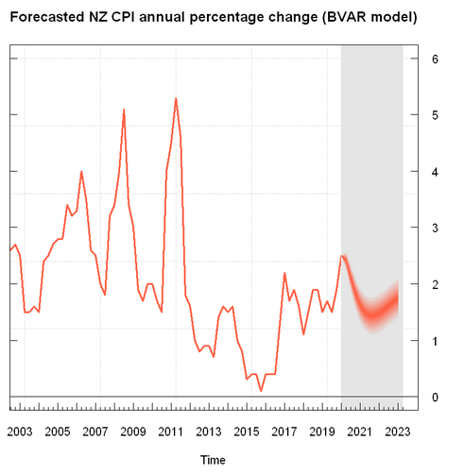
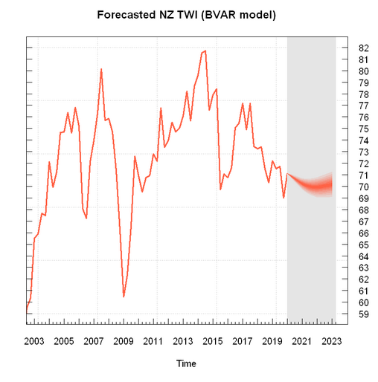
Other Forecasts
Notes:
The forecasted values for CPI % change have a noticeably wider confidence band than the forecasted values for GDP. From the plot, we can see that the CPI seems to have a less consistent trend over time, which would mean that the lagged CPI variables are not as strongly related to the current CPI variable. However, the BVAR model also uses lagged GDP and TWI variables to predict these CPI values, which means that CPI has a weaker relationship than GDP with all three of these macroeconomic indicators.
The forecasted values for TWI seem to have a similar width confidence band to the forecasted values for GDP. From the plot we expect the TWI to be about 70 over the next three year-period.

Slide 14
Comparing Models
Notes:
Our forecast from the BVAR model still seems quite positive, and has fairly similar results to , with an average predicted annual growth rate of around 3.2% by 2023. The major difference between the forecasts from both models is the confidence bands, which are much narrower for the BVAR than the VAR model. This means that the revised predicted GDP growth has less downside and upside risk, with the lower and upper bounds of the credible interval of 2.6% and 3.8%, respectively. This graph is even more confident that the GDP growth rate will not fall below zero in the forecasted three-year period.
Mention: recession. The second quarter of this year had -2.0

